Slide 1

Retirement Planning
Master Class
November 16th, 2019

Slide 2
Agenda
About Us
Market Update
Portfolio Management
Our Services
Retirement Planning
Pensions
Government Programs
Insurance Discussion

Slide 3
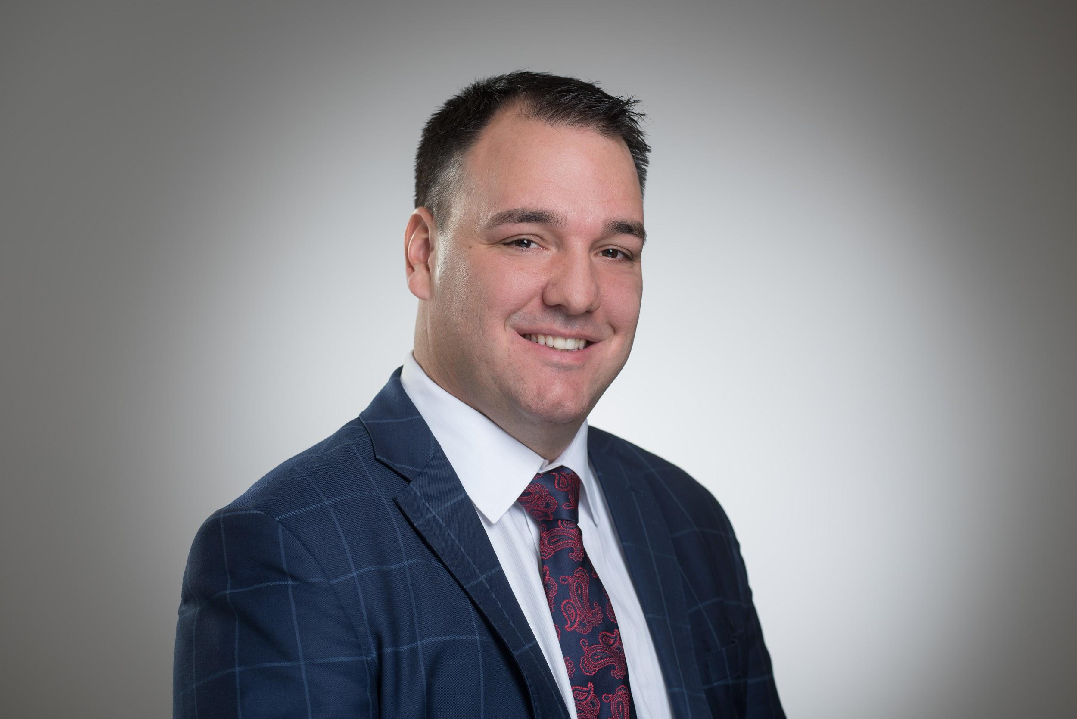



Rob Tétrault, B.A., J.D., MBA, CIM
Notes:
Family Man (Wife & 4 kids)
-National Champion (Settlers of Catan & Chess)
-Previous Lawyer at MLT Aikins
-Finance MBA
-Current Portfolio Manager (CIM®, FCSI)
-Founder and President of Canadian CMV Foundation
-Branch Manager for Canaccord Genuity Wealth Management
-Head of a leading Canadian Private Wealth Management Group

Slide 4
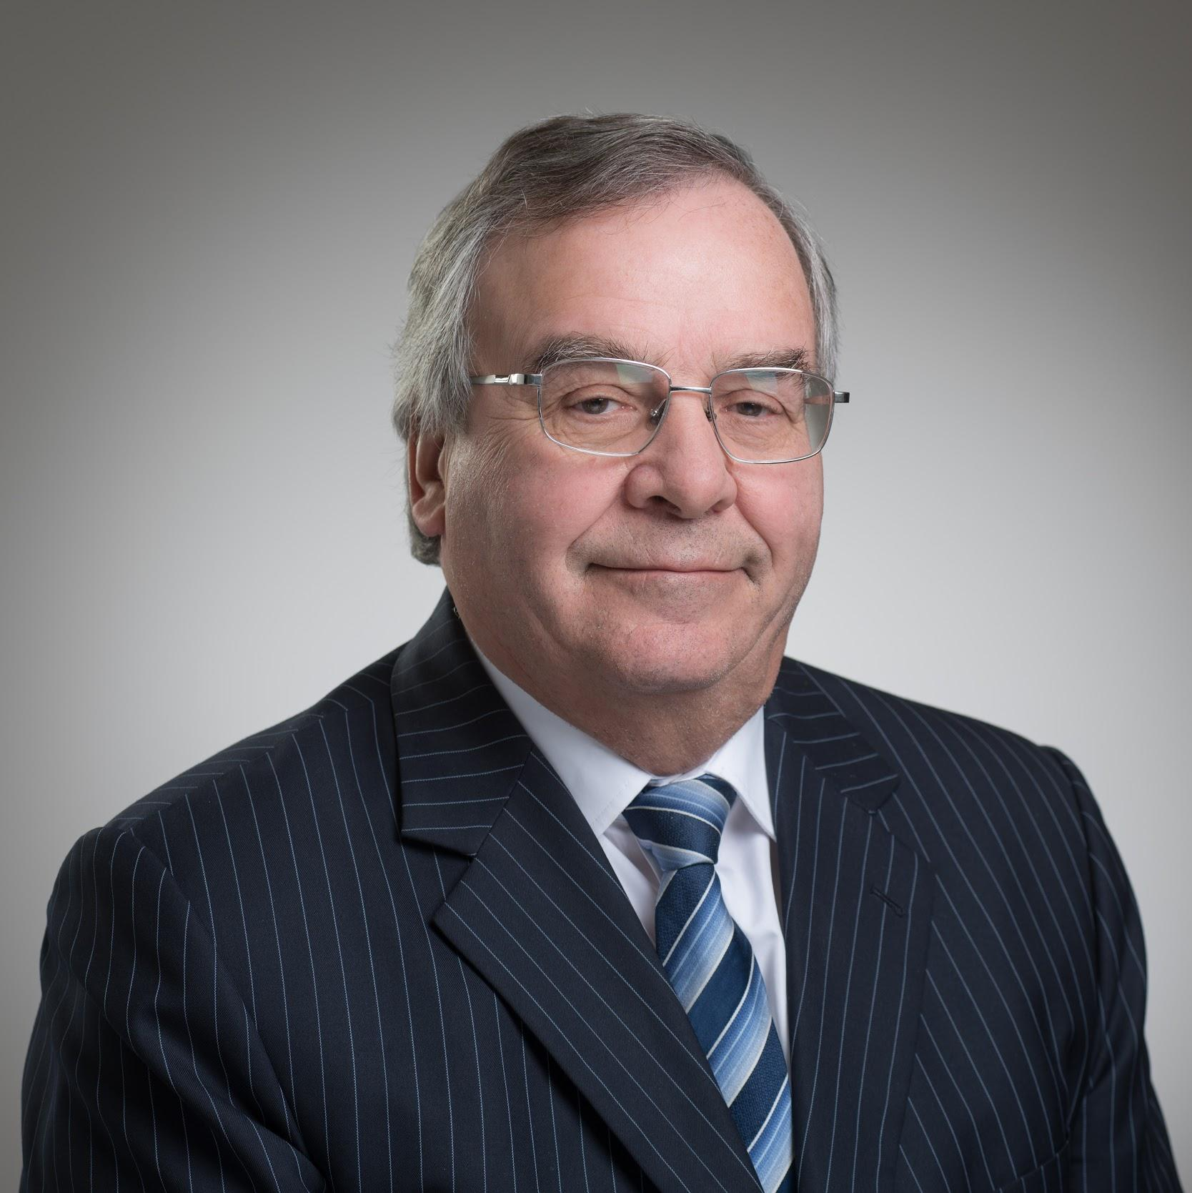


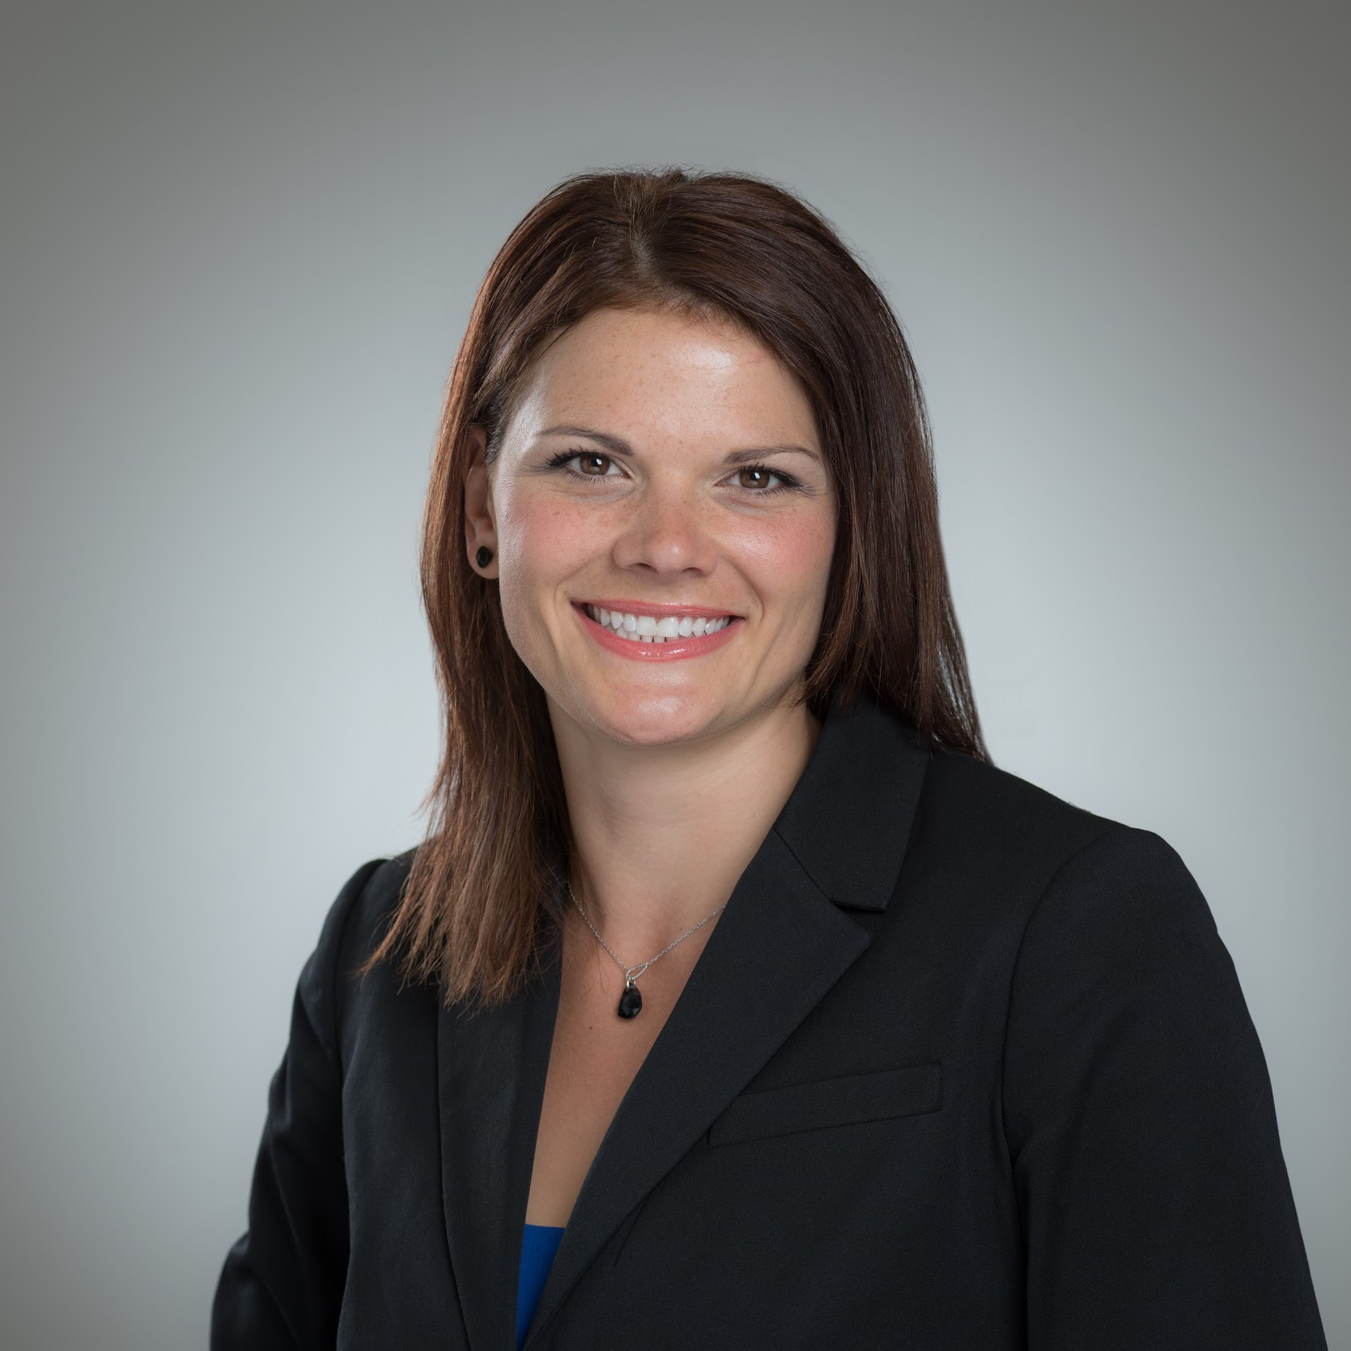
The Team
The Advisory Group providing World Class Investment Solutions
Claude Tétrault
FCSI®
Derrek Funk
Jean Moquin
Karen Kazina
CIM®, MTI®
Investment Associate
Over 40 years of experience in the Investment Industry
Investment Advisor
Over 10 years of experience in the Financial Services Industry
Business Development Associate
Over 5 years of experience in the Digital Marketing Industry
Investment Advisor Assistant
Over 15 years of experience in the Financial Services Industry

Slide 5
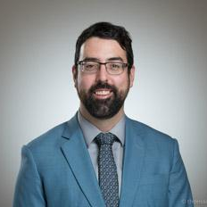
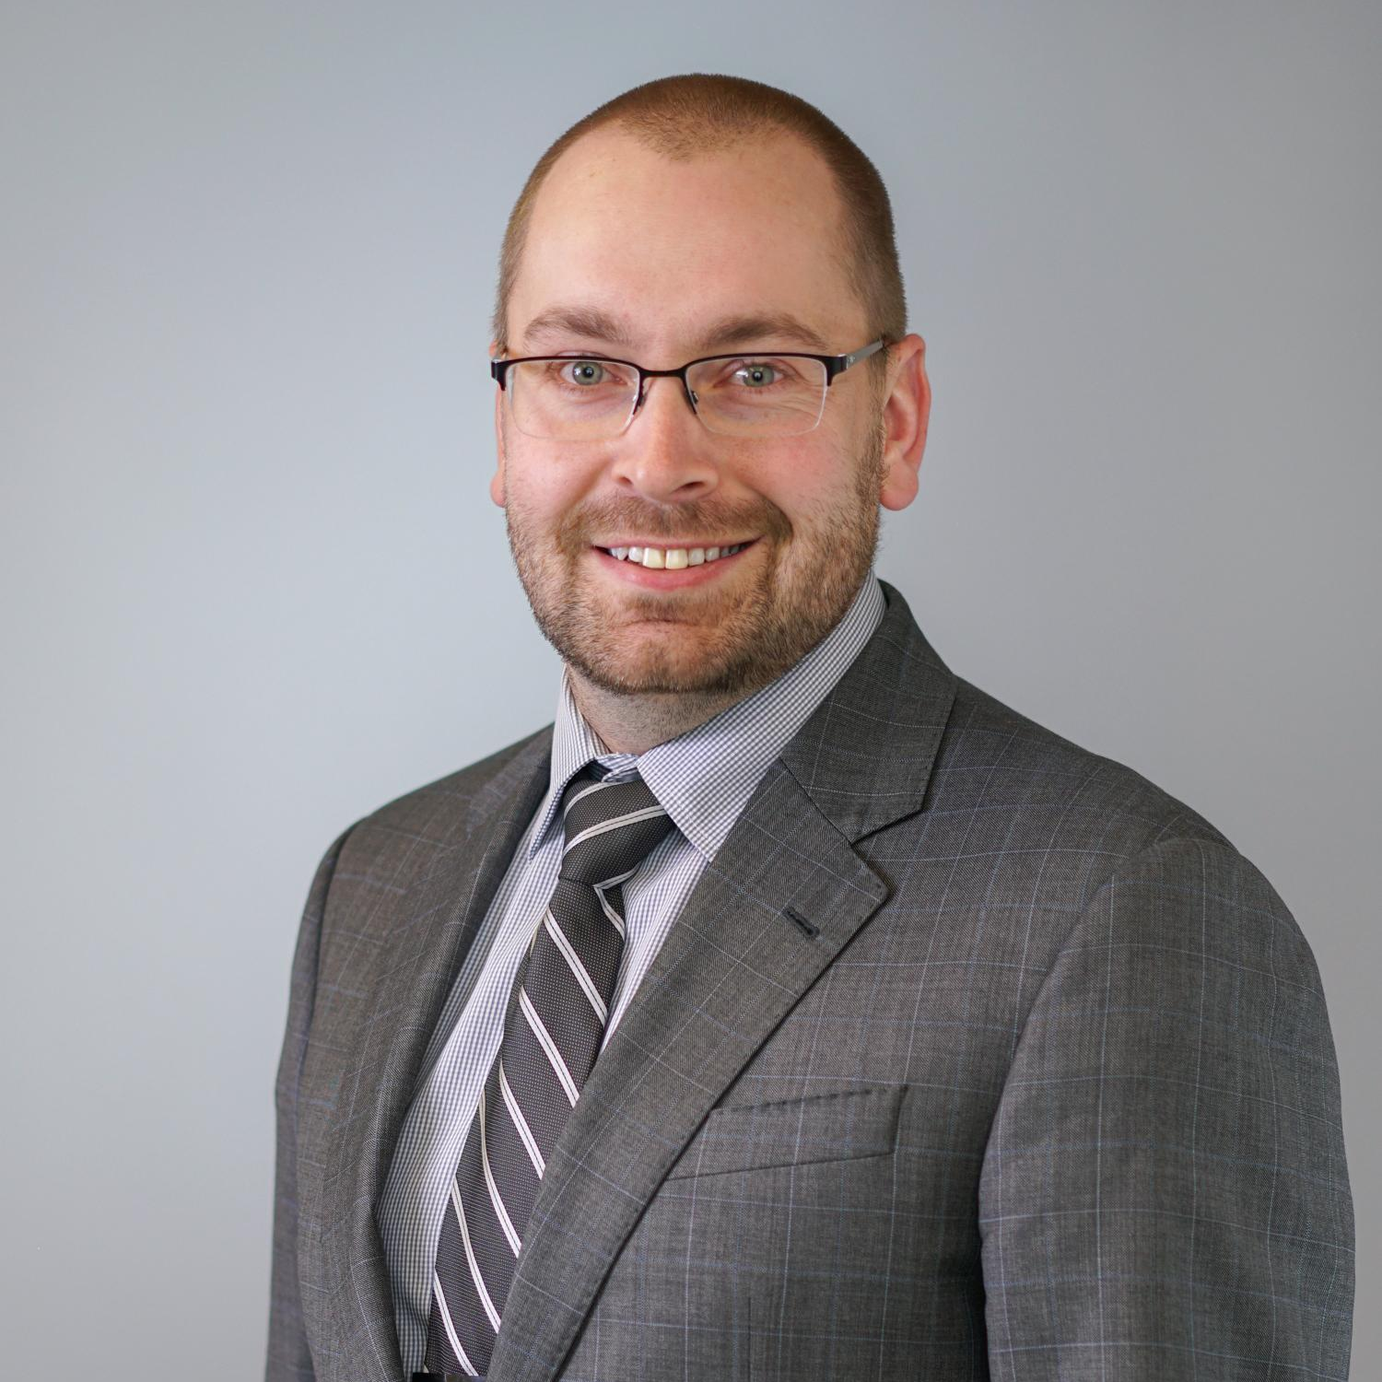


The Team
The Advisory Group solving the financial problems you identified
Jean-Luc Laflèche
Ester Kamenz
Adam Buss
CFP® RRC® FCSI® CLU®
Keri Wersh
Associate
Over 10 years experience in Business Operations
Branch Administrator
Over 5 years of experience in the Financial Services Industry
Investment Associate
Over 20 years of experience in the Financial Services Industry
Wealth and Estate Planning Specialist
Over 15 years of experience in Wealth and Estate Planning

Slide 6
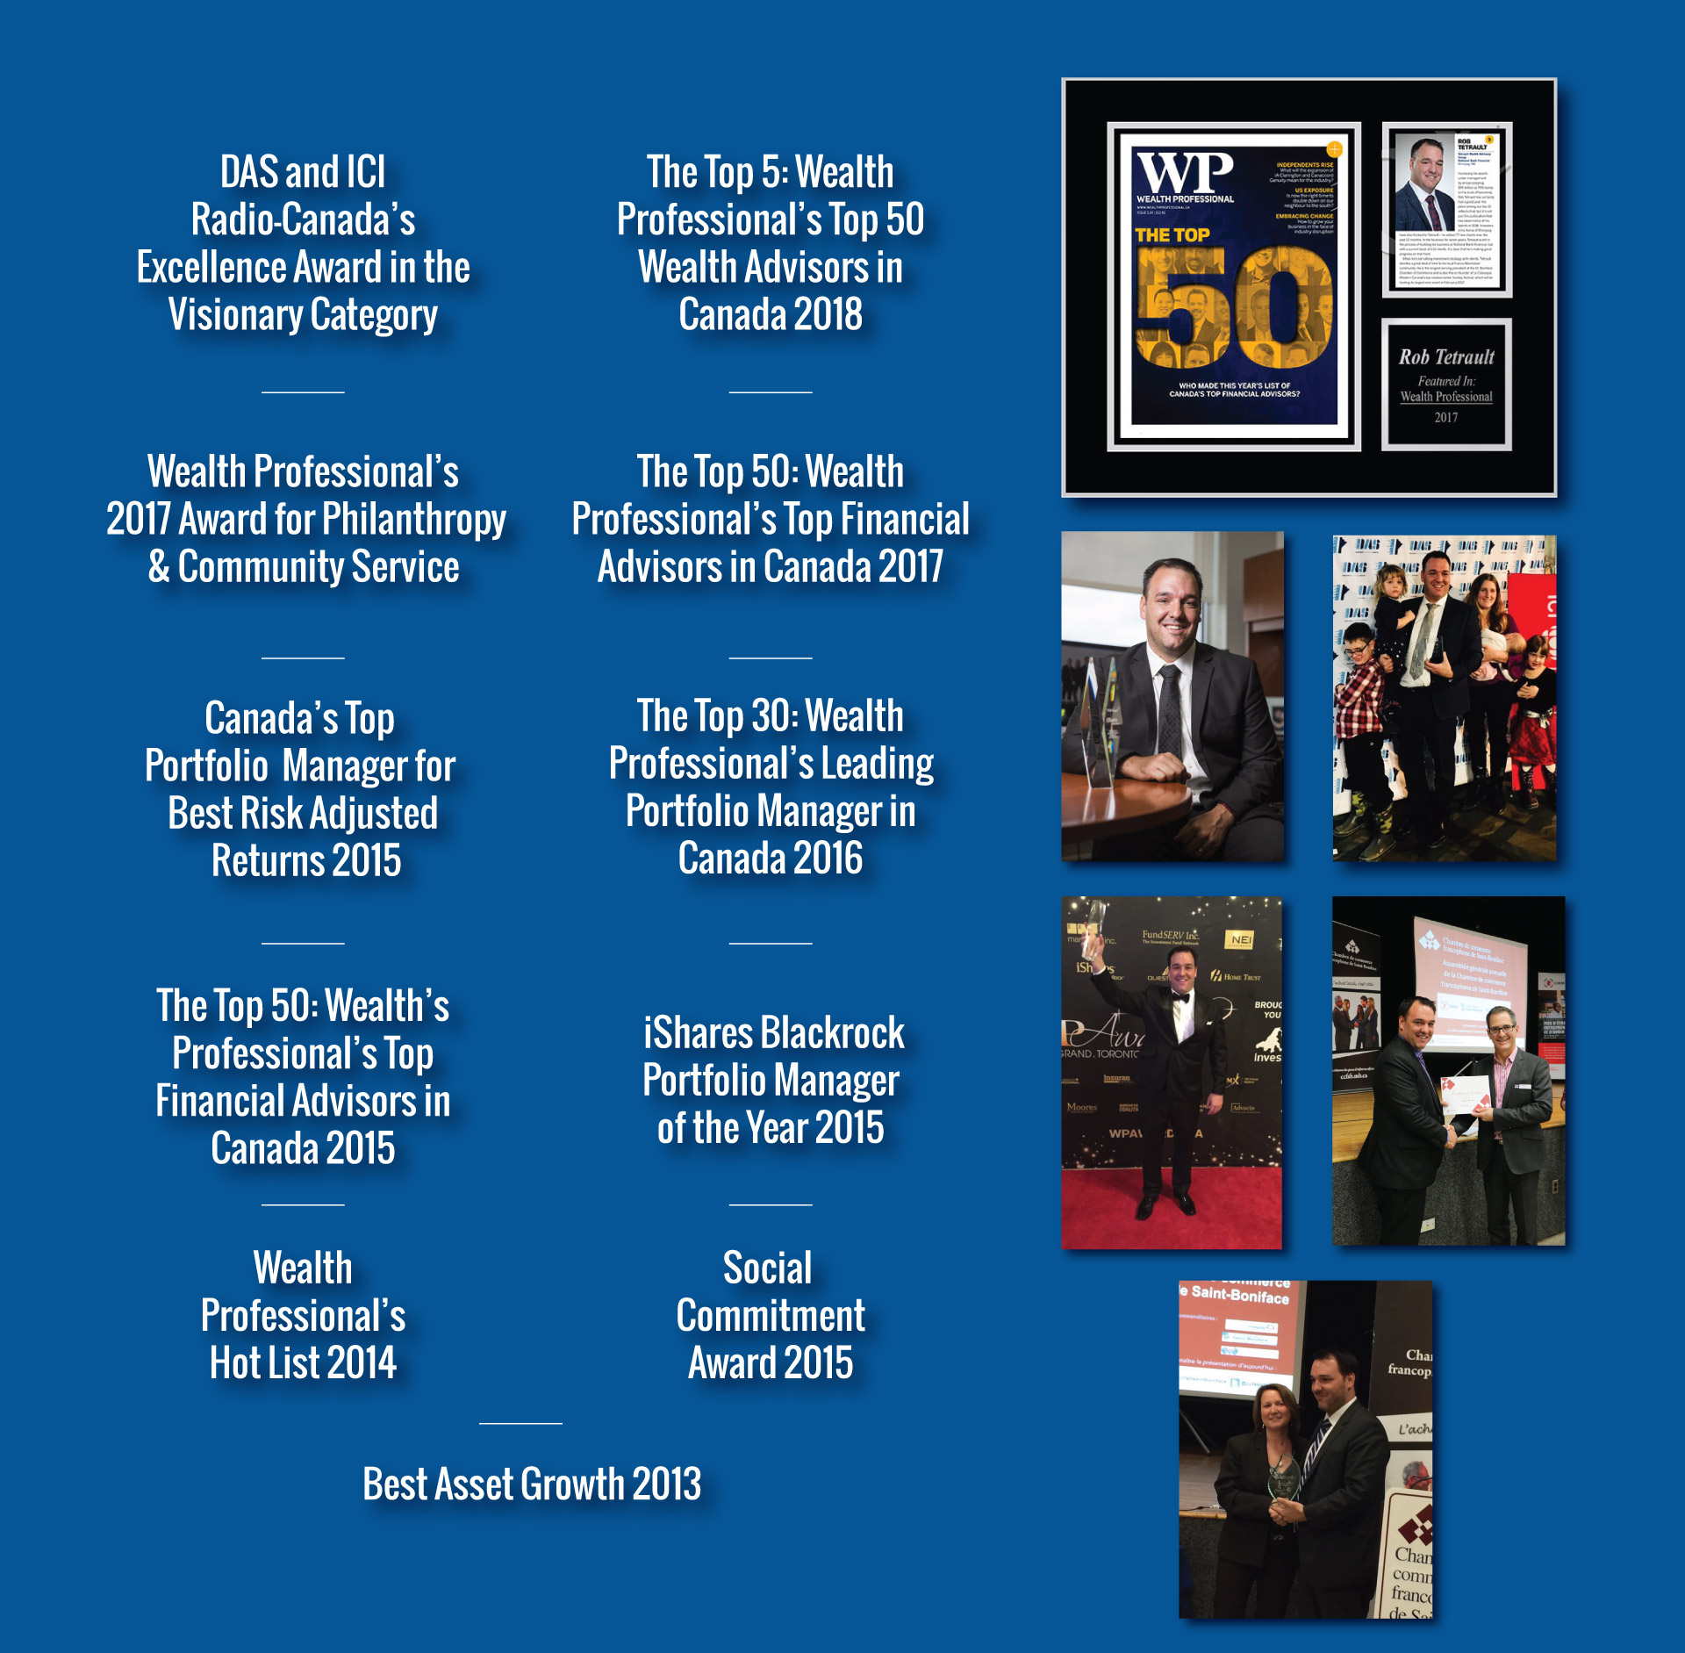

Awards
&
Accolades
Voted #2 in Wealth Professional’s 2018 List of
Top 50 Wealth Advisors in Canada.

Slide 7
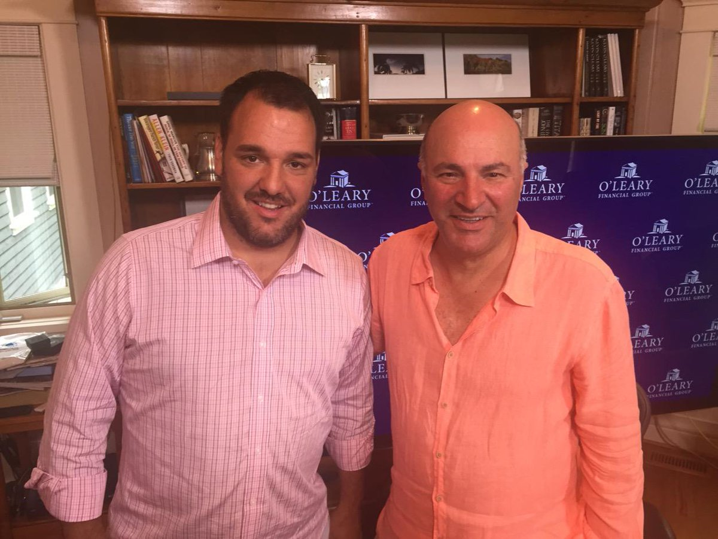
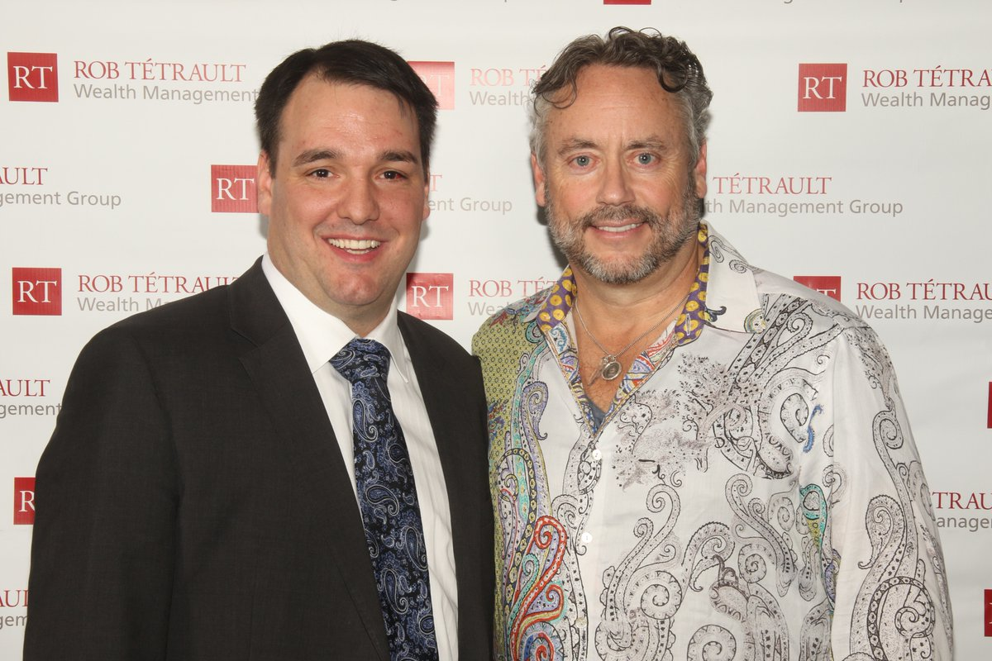
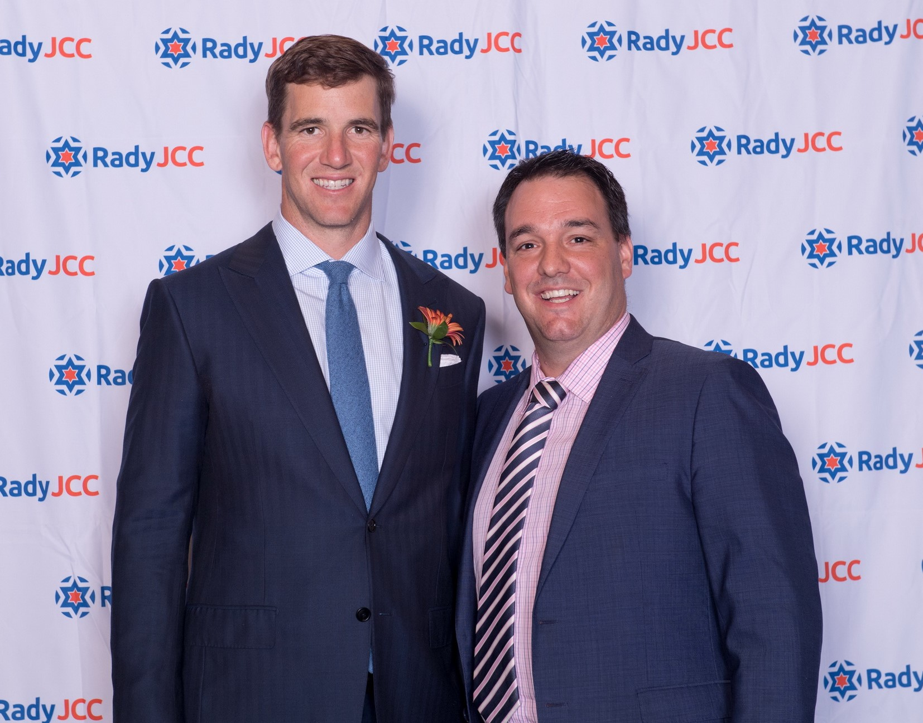
Kevin O’Leary
Brett Wilson
Eli Manning

Slide 8



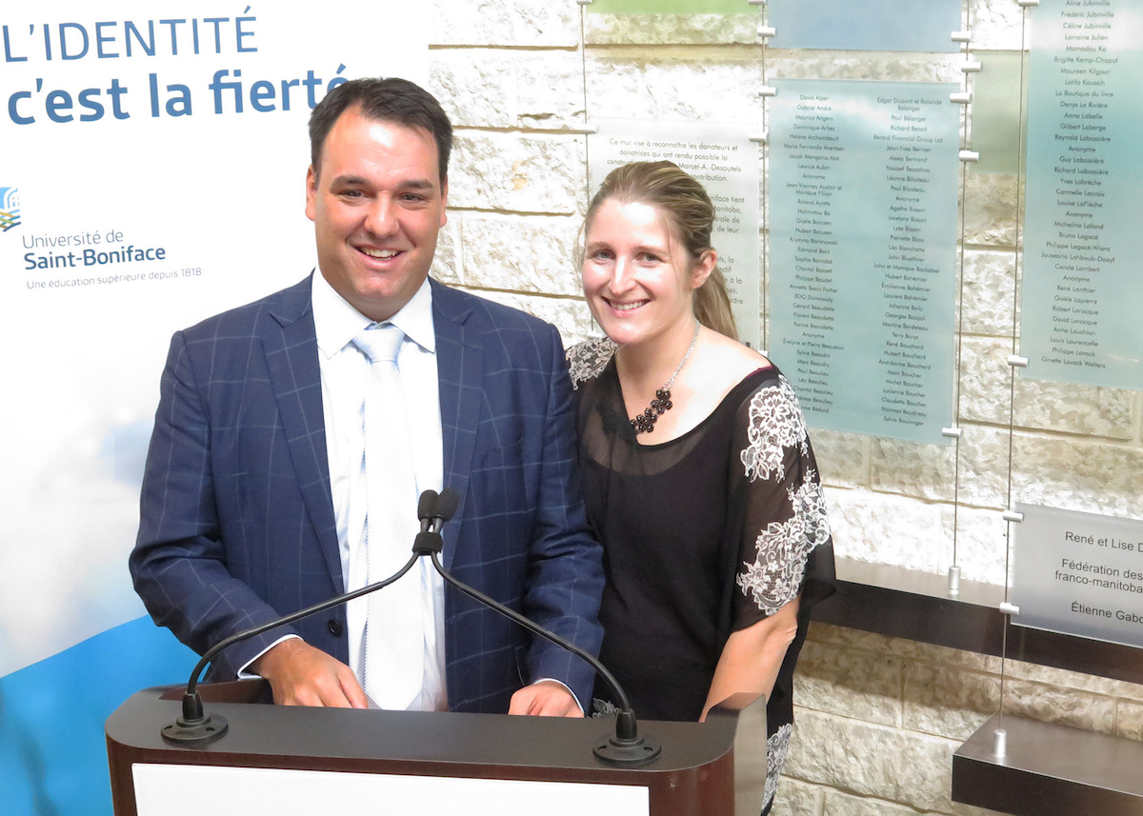
Philanthropy
Fundraising
CMHR
Francofonds
CMV
U. de Saint-Boniface

Slide 9
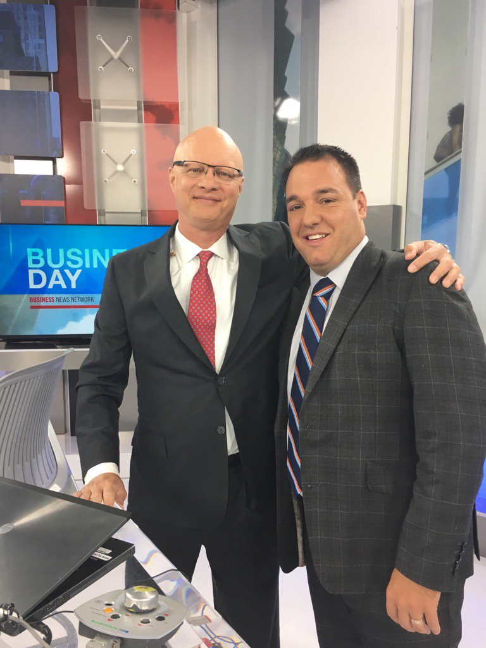
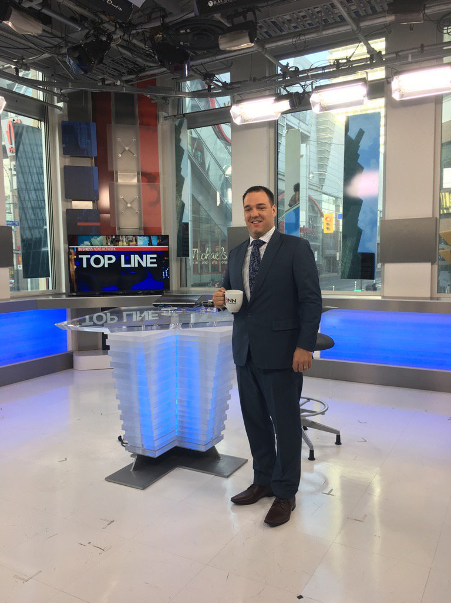
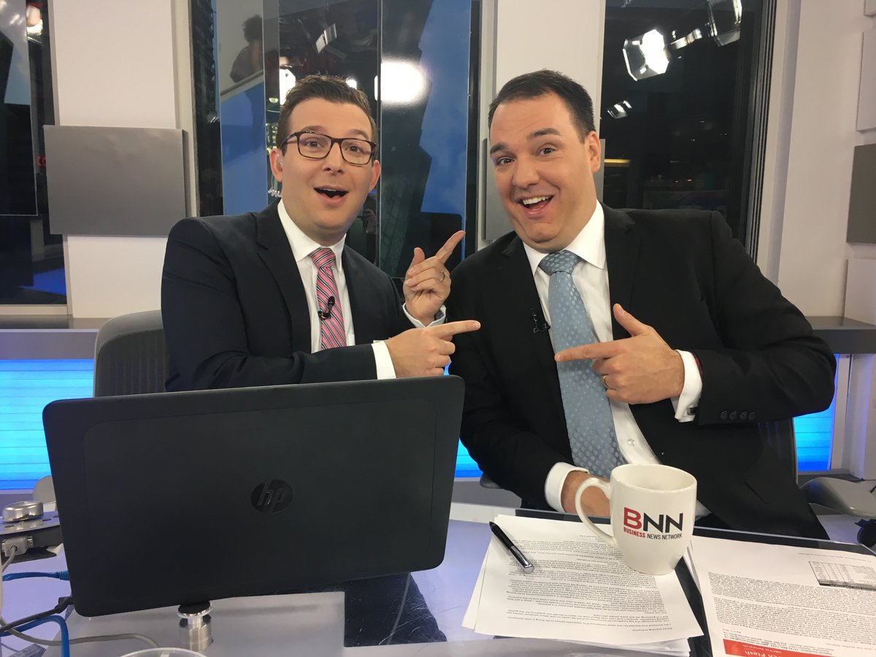
BNN
Bloomberg

Slide 10



Overview of Canaccord Genuity Group Inc.
A leading independent financial services firm with a global presence
Overview
    Strong balance sheet of C$575.6 million working capital¹
    C$61.3 billion in client assets under management and administration¹ at the end of Q4/18
    Comprehensive coverage of the major growth equity buyers – regardless of geography
    Operations in Canada, the US, the UK & Europe, the Middle East and Asia Pacific and capabilities to list companies on 10 stock exchanges worldwide
    Committed to further development in key markets and sectors successfully acquired and integrated six companies in the last ten years
Global presence
Smaller locations not shown
Calgary
Toronto
Montreal
Dublin
London
Vancouver
Nashville
Boston
Paris
Beijing
New York
San Francisco
Houston
Washington, DC
Dubai
Hong Kong
Perth
Sydney
Melbourne
Investment Banking
    193 investment bankers globally²
    FY2018: Led and participated in
    455 transactions, raising over
    C$34.5 billion for clients³
Equity Research
    134 research professionals²
    Broad industry coverage across core sectors
    ~900 companies covered
    Quest® – online valuation tool with 95% global coverage
Sales and Trading
    Equities and Fixed Income
    133 sales and trading professionals²
    10+ fixed income professionals²
    2,260+ institutions covered
    Market making
      ~2,500 companies
      10 exchanges
    C$61.3 billion in client assets under management and administration¹ at the end of Q4/18
    Approximately 300 investment advisors globally¹
    Wealth management offices across Canada, UK, Guernsey,
    Isle of Man, Jersey and Australia
    On and offshore client services
Note: All dollar amounts are stated in Canadian dollars unless otherwise indicated
1. As at 28 June 2018.
2. As at 24 September 2018.
3. Company information as at 31 March 2018. Equity offerings >$1.5m

Slide 11
Portfolio Management

Slide 12
How it works
Step 4
Step 3
Step 2
Step 1
You join the award-winning Tetrault Wealth Advisory Group as a client and benefit from best-risk adjusted returns and world-class advice & service.
Schedule in person meeting (or via Skype/Zoom). We discuss potential Portfolio Allocation, Fees, Return Expectations, Cash Flow, Volatility, Alternatives.
We identify the areas you need help with (Investment, Tax, Insurance, Estate & Retirement).
Discovery call. We get to know you and you get to know us.

Slide 13
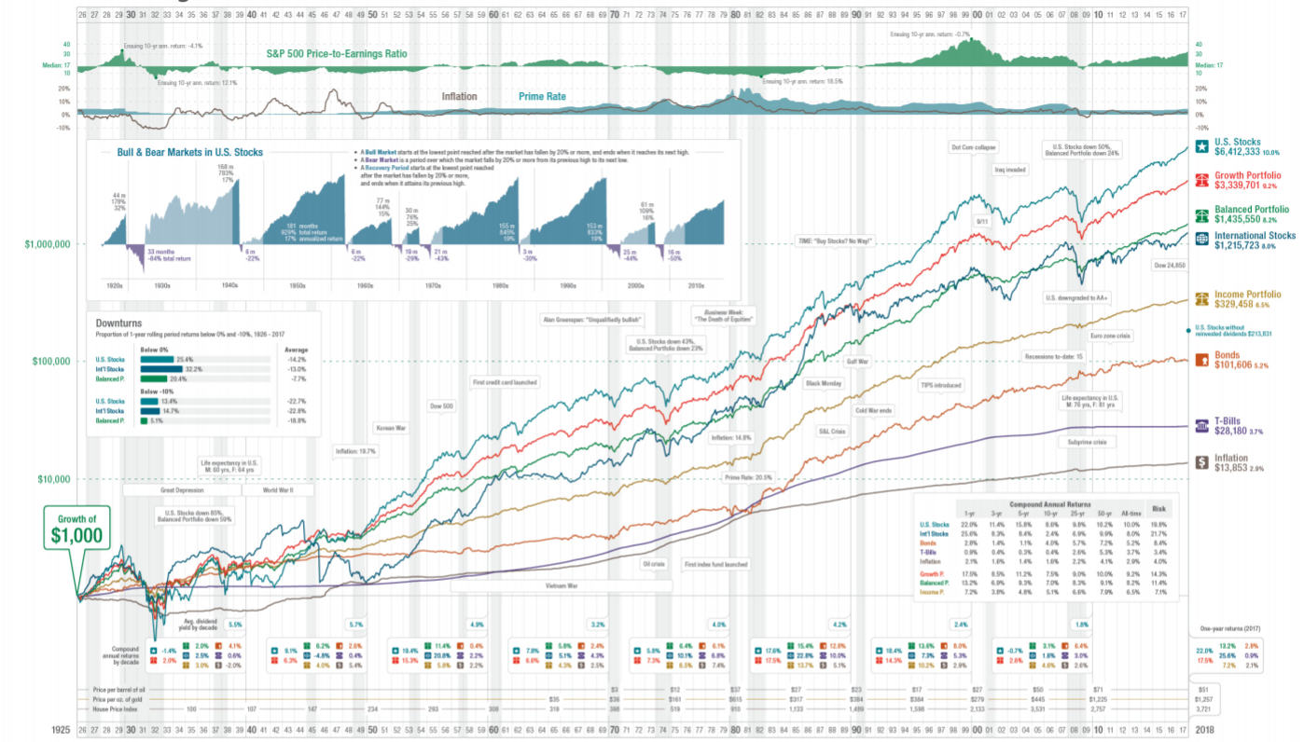

Slide 14
Why Asset Allocation Matters For Retirement?
Bonds vs. Stocks performance over time.
Why do people actually own Bonds?
Volatility vs. Risk.
We evaluate the current and future upside and downside of asset classes.
Why Alternatives?
Bottom Line: Proven track record and asset classes that perform in all markets.

Slide 15
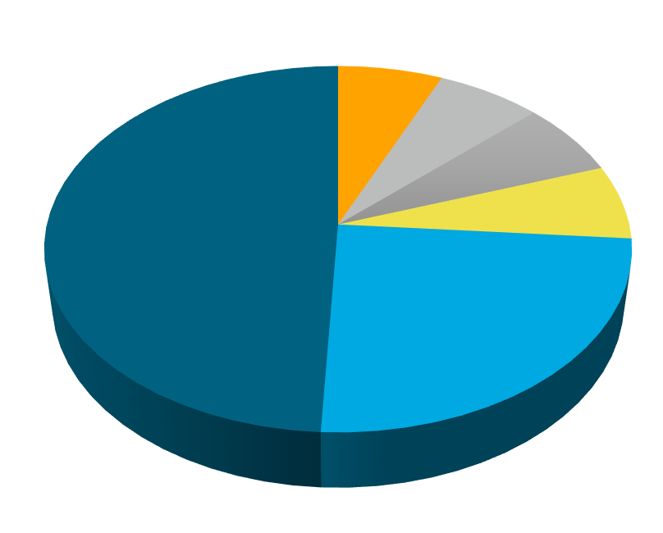
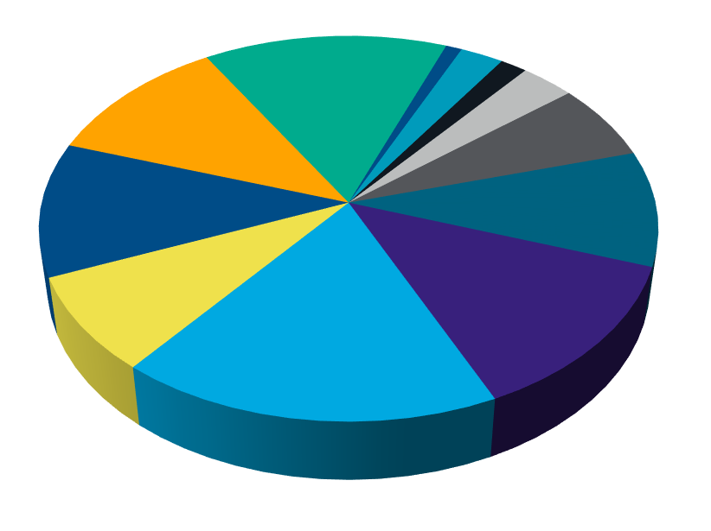
Traditional Portfolio Theory
(60% Growth, 40% Income)
Standard 60/40 Portfolio
Tetrault Wealth 60/40 Portfolio
Cookie Cutter Approach
Our Approach

Slide 16
Market Update

Slide 17
What’s Going on in the Market
Trump Impeachment
US-China Trade War
Oil price volatility - Canadian Election
Brexit
Corporate Earnings
Unemployment
Recession?
Real Estate Event Reminder

Slide 18
What’s a fiduciary obligation?
“A Fiduciary obligation is the highest standard of care that exists at law in a client/professional relationship. It requires the fiduciary to act at all times for the sole benefit and interest of the client. It’s an enhanced level of protection for the client.”
IIROC
Investment Advisor
Fiduciary Obligation
Portfolio Manager
MFDA
Financial Advisor

Slide 19
Investment Planning in Retirement
If you are fortunate enough to have several buckets of retirement proceeds, such as RRSPs/RRIFs, TFSAs, Non-Registered accounts and Corporate Investments, we want to ensure the incomes generated are tax efficient.
Most often an important factor is having your investments generate a steady income stream of tax efficient income...but we can’t forget about growth in retirement, after all the cost of living increases annually!
What rate of return do you need to achieve your lifestyle goals over the next 20, 30 or even 40 years of retirement?

Slide 20
Drawdown Strategy
What order should you draw down or access your retirement nest egg?
Should you convert your RRSP to a RRIF prior to age 71?
Should you take your RRSP first before funds from a corporation?
What tax bracket are you in and how might that change over retirement?
As part of our comprehensive analysis, we want to determine the most tax efficient way to access your funds both in the current year and over your lifetime. Drawing these assets in the right order can result in a substantial long term tax savings….and don’t forget to maximize your TFSA every year too!

Slide 21
Financial Planning
&
Services

Slide 22
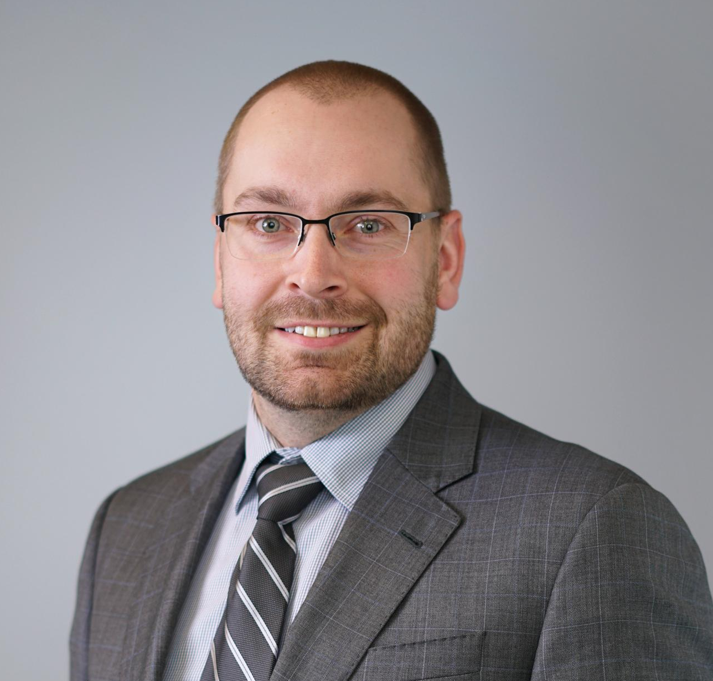
Rob Tétrault, B.A., J.D., MBA, CIM
Adam W. Buss
Wealth & Estate Planning Specialist
CFP® RRC® FCSI® CLU®

Slide 23

Wealth & Estate Planning
  Planning Areas to Address
  Estate Planning (Wills, POA, Health Care Directive)
  Estate Tax planning
  Cottage Succession or Rental Properties
  Insurance Needs Analysis
  Emergency Funds Review
  Education Savings
  Debt Management
  Retirement Planning
  Tax Optimization
  Financial Education
  Business Succession & Corporate Tax Strategies
  Core Services Offered
  Financial & Estate Planning
  Insurance (Life, Disability, Critical Illness and Benefits)
  Referrals to Lawyers & Accountants
  Charitable Foundations
  Additional Services Offered
  Mortgage Brokerage

Slide 24
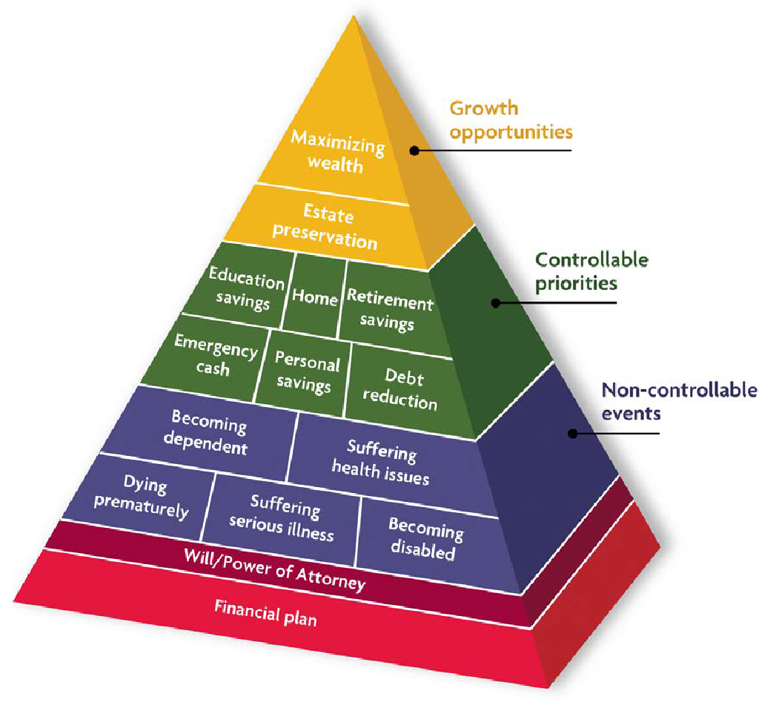
Financial Planning

Slide 25






Financial Planning Process
Gordon B Laing & Associates
CHIMP
MLT Aikins
Concentra Trust
External Partners
BDO
Manulife Private Banking
Engagement
Referral
Discovery Meeting
Analysis
Plan Creation
Presentation Meeting
Follow UP
Annual Review
Draft
Internal Partners
Investment Banking
ICP
Cash Management
Select Portfolios
Insurance

Slide 26
Retirement
Planning

Slide 27
What is YOUR Retirement Vision?
This important thought process helps shape most of your decisions and cash flow needs.
Retirement today is not like it was with past generations, most retirees enjoy a second career, volunteer or in general enjoy a more active retirement.
Notes:
Travel, golf, snow birding, purchasing vacation home, volunteering, second career, hobbies, health concerns….what comfort level of travel you like?
Now that we have a vision of your retirement, we might have a better idea as to what it might cost you...there is no general right answer, there is what suits your lifestyle needs. We always look at your after-tax spending needs.
Will you still carry debt into your retirement?
Are you downsizing your home? Will you rent or buy?
Any extraordinary expenses to factor in to your future needs?
Are you wanting to spend everything?

Slide 28
Retirement MYTHS
All my RRSPs must be withdrawn before turning 71!
RRSPs are terrible and result in more taxes
Only 70% of my income is needed to retire
The Government will look after me

Slide 29

Questions I’ve been asked:
How long will my money last?
How much money do I need to retire?
How will I pay for expenses in retirement?
Should I take my pension as a lump sum?
What’s the best way to drawdown my retirement savings?
Should I have life insurance in retirement?
Do I have enough money put aside for retirement?
How do I pay less tax when I finally draw down my RRSP?
How will taxes impact my income?

Slide 30
Retirement Planning
How much does your current lifestyle cost you?
How will this change in Retirement?
Any other income sources?
Will you have debt?
How will you spend your free time?
Upcoming major expenses?
Any financial dependents?

Slide 31
Importance of Retirement Planning
Optimize your income splitting
What order should you draw down your retirement assets?
Effective RRSP Meltdown
Tax efficiency
Improved Investment Management
Identify your goals
Peace of Mind!

Slide 32
Pension
Planning

Slide 33
Pension Options at Retirement
If you are fortunate to have any form of pension at work, that is a HUGE advantage in your retirement savings efforts. But what happens at retirement?
Defined Benefit Plan - This plan will provide you with a “Guaranteed” payment stream for life and some give you an option to transfer it out as a lump-sum to take over control of the investments. At retirement, you will receive an option letter with several options to choose from...but which is right for YOU!?
Defined Contribution Plan - You and your employer have contributed to this plan over your career. This is a large sum of funds with the option at retirement to transfer it to a LIRA or LIF.

Slide 34
Pension Options Provided
So you just retired, and are overwhelmed with the long list of pension options given by your employer….
Bring the option letter to our office and we can review the options with you and help you choose the BEST solution for your needs!
Notes:
Discuss joint and last options, indexing benefits vs level amount, pension plan funding, SEARS

Slide 35
Commuted Value
You have another option for your pension, which is taking the “Commuted Value”
This is the present value of your future pension payment stream converted to a Lump Sum payout.
This amount can be transferred into a plan that you own and control the investment decisions. This means 100% of the balance can go to your survivor or beneficiaries.
Notes:
Discuss pros and cons
- Lump Sum Example

Slide 36
Sample Retirement Cash Flow
Joe is retiring in 2020 at age 55 with a full pension and no spouse, he elects the Single Life Option of $2383/ BW for life on his pension plan
*Above numbers for illustration purposes, ignoring all tax credits and OAS claw back
Annual Cash Flow for Joe
 | Prior to 65 | After 65
Pension | $61,958.00 | $61,958.00
CPP | $0.00 | $13,854.96
OAS | $0.00 | $7,217.40
Gross Annual Income | $61,958.00 | $83,030.36
(Less Taxes) | -$14,494.00 | -$22,078.00
Net Annual Income | $47,464.00 | $60,952.36
Net Per Month | $3,955.33 | $5,079.36
Notes:
What if Joe required $6000/month to maintain his lifestyle? We need to come up with $2000/net more per month to get to this before 65 and $1000/net more per month after 65, but more taxable income leads to more OAS claw back.

Slide 37
Government
Retirement
Benefits

Slide 38
Canada Pension Plan – Details!
Contributory Plan
Start as early as age 60 or defer till up till age 70
Indexed Benefit
Current Maximum = $1154.58
Average Benefit at age 65 = $679.16
MYTH – CPP will run out before I retire
Notes:
Best 32 of 40 years
Child Rearing Drop Out provision
Go online or call CPP for Quote
CPP Sustainability 75 yrs + = $361 Billion in assets

Slide 39
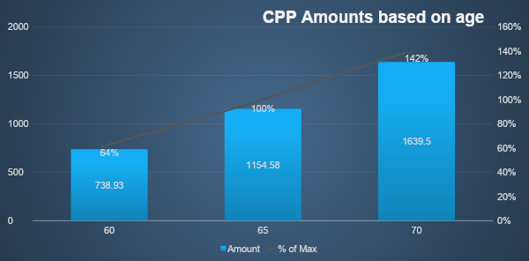
CPP – Canada Pension Plan
*Based on current Maximum CPP amounts and reductions. We recommend verifying your eligibility based on your contribution history.
Notes:
.60% reduction every month prior to age 65
.70% bonus every month deferred past 65

Slide 40
When should I start CPP?
IT DEPENDS!
Are you still working?
Do you need the cash?
Shortened Life Expectancy or Health Concerns
Have you created a financial plan?

Slide 41
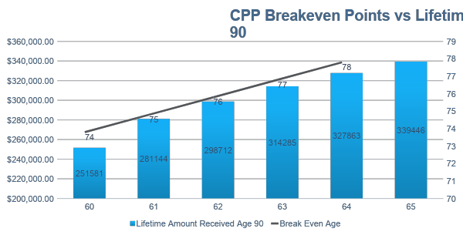
CPP Breakeven Points
*Based on current maximum CPP amounts and reductions based on start ages and have not been adjusted for inflation or taxation. Taxation levels and saving contributions can have a large impact on the results We recommend reviewing your unique situation in deciding when is the right time to start receiving your CPP benefits.

Slide 42
CPP Death Benefits and Survivor Benefits
CPP Death Benefit - $2500 Lump Sum
CPP Survivors Benefit
Up to 60% of your Pension to the maximum one person is entitled to
$250.27 per dependent
Fact – If each spouse is eligible for the Maximum CPP benefit per month of $1154.58, the survivor does NOT get double the CPP, the one CPP benefit disappears after death
Notes:
If the survivor is:Then the survivor's pension is:age 65 or more60% of the contributor's retirement pension if the surviving spouse or common-law partner is not receiving other CPP benefitsunder age 65a flat rate portion
plus
37.5% of the contributor's retirement pension, if the surviving spouse or common-law partner is not receiving other CPP benefits

Slide 43
OAS – Old Age Security
Non-Contributory Plan
Funded from tax dollars
Fixed Amount per month, currently $601.45/month
Start at age 65 or defer till age 70 (.60% deferral bonus per month deferred)
Claw Back of Benefits based on Taxable income ($77,580 to $125,696)
Indexed Benefits
Notes:
OAS (Old Age Security)
Current Maximum at age 65 = $601.45/month
No option to take prior to 65
Increases if taken after age 65, max deferral till age 70
Indexed to inflation
1/40th of benefit for every year as resident of Canada after age 18
Non-contributory
Clawed back based on taxpayer’s annual income
Most people are retired by 65 and then start taking it, if you are still working at age 65, you may wish to defer it...

Slide 44
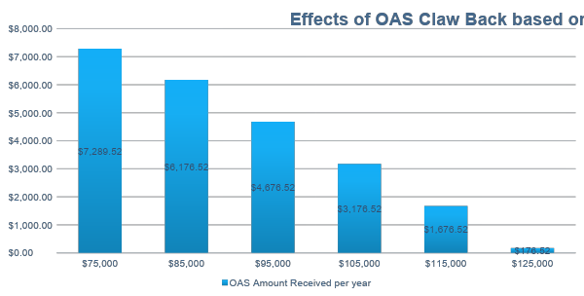
What is OAS Claw Back?

Slide 45
Tax Planning Strategies

Slide 46
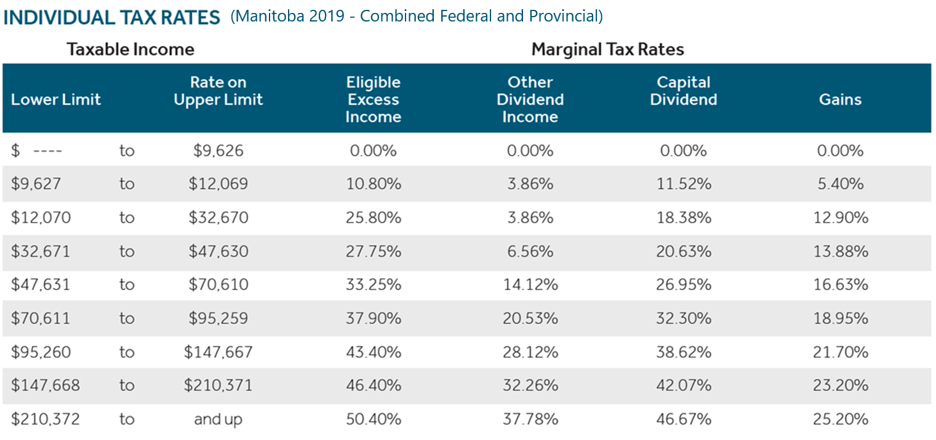
Current Manitoba Tax Rates

Slide 47
RRSP Withholding Taxes
Mandatory Withholding Taxes on Severance, RRSPs, RRIFs
Withholding Tax % based on Withdrawals
10% = <$5000
20% = $5000.01 - $15,000
30% = > $15,000.01
You can elect additional withholding taxes to avoid large unexpected tax bills

Slide 48
Income Splitting – Eligible Income
Have each spouse in a similar tax bracket, thereby reducing your overall taxes paid as a couple.
Before age 65
Periodic payments received directly from a defined benefit pension plan.
Once you are 65 or older during the year
Periodic payments received directly from a defined benefit pension plan.
Payments received from a RRIF, LIF, or LRIF.
Payments received from annuities purchased with the proceeds of an RRSP, RRIF, LIF, or LRIF.
The taxable portion of payments received under certain types of annuity contracts purchased with non-registered funds (typically prescribed annuity contracts).
Funds from RRSP withdrawals do NOT qualify for income splitting!

Slide 49
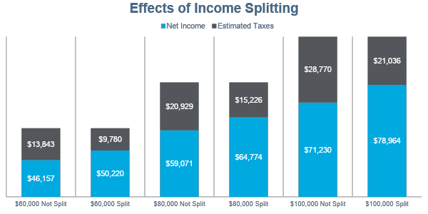
Income Splitting Illustration
$ 4063 savings! $5703 savings! $7734 savings!
*Based on estimated Manitoba Tax rates using EY.com tax calculator and assuming a full 50/50 income split. OAS claw back and tax credits not factored into calculations. Information is intended for illustration purposes and not implied tax advice.

Slide 50
Maximizing your TFSA
(Tax-Free Savings Account)
Same investment options as your RRSP
Current Lifetime Contribution limit of $63,500
Annual contributions $6000
Great source of additional funds to supplement your lifestyle need without taxation!

Slide 51
Your
Insurance
Needs

Slide 52
What are your Insurance needs?
What insurance to you have in place?
When was the last time you reviewed it?
What impact would a change in health or premature death have on your family’s finances?
Do your children have insurance coverage?
Have you completed an insurance analysis before?

Slide 53
Life Insurance
The recommended Life Insurance Coverage is generally 7 – 15 x Annual Income
Example $100,000 Salary = $700,000 to $1,500,000 in coverage.
The average Canadian has only 5 x of Annual Income in Life Insurance
Insurance needs evolve over time
Insurance needs do NOT stop at retirement
Do you have long term tax consequences? – Cottage, rental properties, business, etc
What happens if your surviving spouse receives less pension, loses a CPP and potentially both OAS?

Slide 54
Critical Illness Insurance
TAX-FREE lump-sum payout upon diagnosis of a qualifying covered illness
Aortic Surgery
Aplastic Anemia
Bacterial Meningitis
Benign Brain Tumor
Blindness
Cancer (Life Threatening)²
Coma
Coronary Angioplasty
Coronary Artery Bypass Surgery
Deafness
Dementia including Alzheimer’s Disease
Early Breast Cancer
Early Prostate Cancer
Early Skin Cancer
Early Stage Blood Cancer
Early Stage Intestinal Cancer
Early Thyroid Cancer
Heart Attack
Heart Valve Replacement or Repair
Kidney Failure
Loss of Independent Existence
Loss of Limbs
Loss of Speech
Major Organ Failure on Waiting List
Major Organ Transplant
Motor Neuron Disease
Multiple Sclerosis
Occupational HIV Infection
Paralysis
Parkinson’s Disease and Specified Atypical Parkinsonian Disorders
Severe Burns
Stroke
What impact would a serious illness have
on your family?

Slide 55
Disability Insurance
“It won’t happen to me!”
1 in 3 Canadians will experience a period of disability lasting longer than 90 days
Sources of Coverage:
Emergency fund of 3-6 months living expenses = $16,250 - $32,500
EI Benefits for 15 weeks, max $562/week ($8430 total taxable!)
CPP Disability (Severe and prolonged disability only)
Banked Sick Leave
Long Term Disability after 6 months waiting period (66.66% of Income)

Slide 56
Summary

Slide 57
Benefits of Partnering with our Team!
Learn & apply proven real-world advice from a national award-winning firm.
Peace of mind & less stress.
More time to enjoy the things you want to do.
Protect your capital, generate income & get great risk-adjusted returns.
Secure your family’s future.
Difference between retiring comfortably or continuously doubting your financial situation.
Dealing with a Portfolio Manager IIROC licensed, who owes you a fiduciary duty along with a in-house Certified Financial Planner
Canaccord Genuity Wealth Management is a member of the CIPF.

Slide 58
Questions!

Slide 59




CONTACT INFO
www.RobTetrault.com
www.SpeakToRob.com
(204) 259-2859
https://www.linkedin.com/in/robtetrault/
Rob Tetrault – Tetrault Wealth
https://www.facebook.com/RobTetrault.TetraultWealth/
robtetrault_tetraultwealth

Slide 60
Thank you!

Slide 61
Disclaimer
  This material is provided for information purposes only and is intended for distribution in those jurisdictions where subsidiaries of Canaccord Genuity Group Inc. (together, “Canaccord Genuity”) are registered as advisors or dealers in securities. Any distribution or dissemination of this material in any other jurisdiction is strictly prohibited. The information does not constitute an offer or solicitation in any jurisdiction in which such an offer or solicitation is not authorized, or to any person to whom it is unlawful to make such an offer or solicitation. This is not, and under no circumstances should be construed as, a solicitation to act as a securities broker or dealer in any jurisdiction by any person or company that is not legally permitted to carry on the business of a securities broker or dealer in that jurisdiction. This material is prepared for general circulation to clients and does not have regard to the investment objectives, financial situation or particular needs to any person. Clients should obtain advice based on their own individual circumstances before making an investment decision. Any client wishing to effect any transactions should do so through a Canaccord Genuity qualified salesperson in their jurisdiction of residence.
  The information contained herein has been compiled by Canaccord Genuity from sources believed to be reliable, but no representation or warranty, express or implied, is made by Canaccord Genuity or any other person to its fairness, accuracy, completeness or correctness. To the fullest extent permitted by law, neither Canaccord Genuity nor any other person accepts any liability whatsoever for any direct or consequential loss arising from any use of the information contained herein.
  All material presented in this document, unless specifically indicated otherwise, is under trademark and copyright to Canaccord Genuity. None of the material, or its content, or any copy of it, may be altered in any way, or transmitted to or distributed to any other party, without the prior express written permission of Canaccord Genuity.
  Copyright © Canaccord Genuity Corp. 2018. – Member IIROC/Canadian Investor Protection Fund Copyright © Canaccord Genuity Limited 2018. – Member of the London Stock Exchange, authorized and regulated by the Financial Conduct Authority.
  Copyright © Canaccord Genuity LLC 2018. – Member FINRA/SIPC
  Copyright © Canaccord Genuity (Australia) Limited 2017. – Authorized and regulated by ASIC.
  CAUTIONARY STATEMENT REGARDING FORWARD-LOOKING INFORMATION
  This document may contain certain “forward-looking information” (as defined under applicable securities laws). These statements relate to future events or future performance and include management’s expectations, beliefs, plans, estimates, intentions, and similar statements concerning anticipated future events, results, circumstances, performance or expectations that are not historical facts, business and economic conditions and Canaccord Genuity Group LLC’s (the “Company”) growth, results of operations, market position, ability to compete and future financial or operating performance of the Company, performance and business prospects and opportunities. Such forward-looking information reflects management’s current beliefs and is based on information currently available to management. In some cases, forward-looking information can be identified by terminology such as “may”, “will”, “should”, “expect”, “plan”, “anticipate”, “believe”, “estimate”, “predict”, “potential”, “continue”, “target”, “intend”, “could” or the negative of these terms or other comparable terminology. By its very nature, forward-looking information involves inherent risks and uncertainties, both general and specific, and a number of factors could cause actual events or results to differ materially from the results discussed in the forward-looking information. In evaluating these statements, readers should specifically consider various factors, which may cause actual results to differ materially from any forward-looking statement. These factors include, but are not limited to, market and general economic conditions, the nature of the financial services industry, the risks and uncertainties discussed from time to time in the Company’s interim and annual consolidated financial statements and its Annual Information Form filed on www.sedar.com. Readers are cautioned that the preceding list of material factors or assumptions is not exhaustive. Except as may be required by applicable law, the Company does not undertake, and specifically disclaims, any obligation to update or revise any forward-looking information, whether as a result of new information, future developments or otherwise.

